Slide 1
Sequence Oriented DBMS Fuzzing
Jie Liang¹ , Yaoguang Chen² , Zhiyong Wu¹, Jingzhou Fu¹, Mingzhe Wang^{1,3}, Yu Jiang¹
Xiangdong Huang¹ , Ting Chen⁴ , Jiashui Wang², Jiajia Li¹
¹School of Software, Tsinghua University, Beijing, China
²Ant Group, China
³ShuiMuYuLin Ltd, China
⁴UEST-Center for Cybersecurity, China
Notes:
15 minutes

Slide 2
DBMS Fuzzing
Seeds /
Grammar
Generator
Data
DBMS
Detector
Bugs
Queries
Oracle
Feedback
Notes:
Introduce DBMS Fuzzing
Fuzzing

Slide 3
SQL Type Sequences
SQL Statement Types
Original Seed
Mutation Areas
1:CREATE TABLE t1(v1 INT, v2 INT);
2:INSERT INTO t1 VALUES(1, 1);
3:INSERT INTO t1 VALUES(2, 1);
4:SELECT FROM t1 ORDER BY v1;
5:SELECT v2 FROM t1 WHERE v1=1;
DDL: CREATE/DROP/ALTER TABLE, …
DQL: SELECT
DML: INSERT INTO, DELETE FROM, …
DCL: GRANT, REVOKE, …
…
Test Case
*
Statement
Mutated Seed
SQL Type Sequence
… …
5:SELECT v2 FROM t1 ORDER BY v1;
Mutate
Notes:
Generally, SQL statements have hundreds of types. Type is the category divided by the same functionalities, like SELECT and INSERT. SQL Type Sequence is a sequence of the types for each SQL statement in a test case (surrounded by the red box)
The abundance of SQL Type Sequences contained by generated test cases is crucial for fuzzing a DBMS.
As the figure shows, a test case (surrounded by the grey box) is an input for a DBMS, and it always consists of a sequence of SQL statements (surrounded by the orange box)

Slide 4
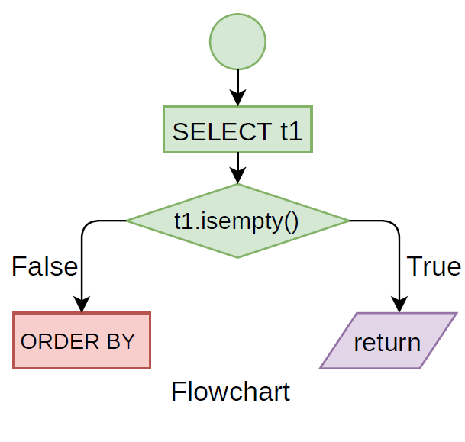
Importance of Abundant SQL Type Sequences
Richness
1:CREATE TABLE t1(a INT, b VARCHAR(100));
2:INSERT INTO t1 VALUES(1, ’name1’);
3:INSERT INTO t1 VALUES(3, ’name1’);
4:SELECT * FROM t1 ORDER BY a DESC;
Functions Covered
Permutations
1:CREATE TABLE t1(a INT, b VARCHAR(100));
2:SELECT * FROM t1 ORDER BY a DESC;
3:INSERT INTO t1 VALUES(1, ’name1’);
4:INSERT INTO t1 VALUES(3, ’name1’);
Specific Logic
Generating abundant sequences could help fuzzers explore more state spaces of the DBMS.
Notes:
For example, the two test cases Q1 and Q2 in Figure 2 have the same combinations of three statements (i.e., 1 CREATE TABLE, 1 SELECT, and 2 INSERT). However, Q1 gets sorted data but Q2 obtains empty results because of the different execution orders. Specifically, Q1 fetches the data after inserting them, while Q2 queries the data before they are prepared

Slide 5

Challenge in Generating Abundant SQL Type Sequences
Naive Method: Arbitrarily permuting or combining types
C1: Enormous state space
C2: Meaningless sequences
C3: Unsuitable test cases for fuzzing
Current Status and Potential Solution
Generation-based fuzzers: lack related rules → Manually add
Mutation-based fuzzers: change individual statements → How?
Notes:
For example, the two test cases Q1 and Q2 in Figure 2 have the same combinations of three statements (i.e., 1 CREATE TABLE, 1 SELECT, and 2 INSERT). However, Q1 gets sorted data but Q2 obtains empty results because of the different execution orders. Specifically, Q1 fetches the data after inserting them, while Q2 queries the data before they are prepared

Slide 6
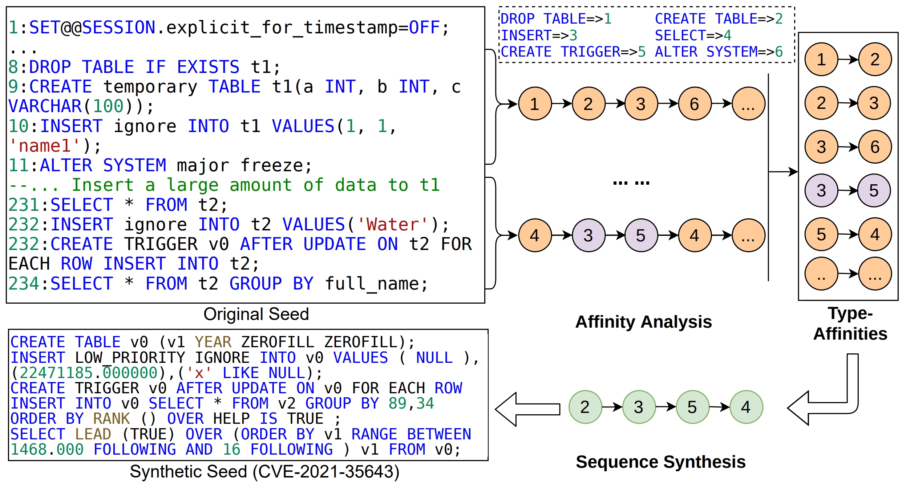
Basic idea of LEGO
Notes:
LEGO explores the SQL type space to proactively analyze the affinities between types. It then exploits these affinities to generate high-quality test cases, which contribute to the abundance of SQL Type Sequence and are suitable for fuzzing.
LEGO introduces type affinity to abstract the problem of synthesizing meaningful SQL Type Sequences. Specifically, type-affinity is a chronological relation between the types of adjacent SQL statements. LEGO uses type-affinity to determine what type of statements should be concatenated after an existing one, thus enabling the exploration of a wide range of state spaces while ensuring that meaningful sequences are generated.
LEGO first explores new type-affinities by performing sequence-oriented mutations on existing test cases. To ensure that affinities are meaningful, LEGO performs affinity analysis only on seeds that cover new branches in the target DBMS.
Figure 3 shows the process of LEGO to produce a test case that crashes MySQL server. The bug has been assigned CVE-2021-35643 by Oracle because of the severe consequences: it could be used to break down the MySQL servers directly via the network. To generate the test case, a specified SQL Type Sequence should first be synthesized. For simplicity, we use 1 to 6 to represent the type “DROP TABLE”, “CREATE TABLE”, “INSERT”, “SELECT”, “CREATE TRIGGER”, and “ALTER SYSTEM”, respectively. Note the original test case is rather long and the figure only shows a part of that. LEGO first extracts typeaffinities in its SQL Type Sequence. For example, from line 8 to 11, the sub sequence is “ 1 → 2 → 3 → 6 ”, and from line 231 to 234, the sub sequence is “ 4 → 3 → 5 → 4 ”. From the SQL Type Sequence, LEGO finds a new typeaffinity, namely “an INSERT statement could be followed by a CREATE TRIGGER statement” (i.e., 3 → 5 in the figure).
With the new type-affinity, LEGO synthesizes new sequences containing it and instantiates the sequences into test cases. The synthesized test cases are usually short in sequence length, simple in SQL structures but abundant in SQL types, and some of them may cover new coverage or directly trigger new crashes. In Figure 3, we also show a synthesized test case that crashes the MySQL server. The sequence of it is “ 2 → 3 → 5 → 4 ”. We can find that the new seed is much shorter while having a different sequence. Seeds like it can be executed at a high speed and help fuzzer to explore new state-space quickly. Based on the specified sequence, LEGO finally triggers the crash.

Slide 7
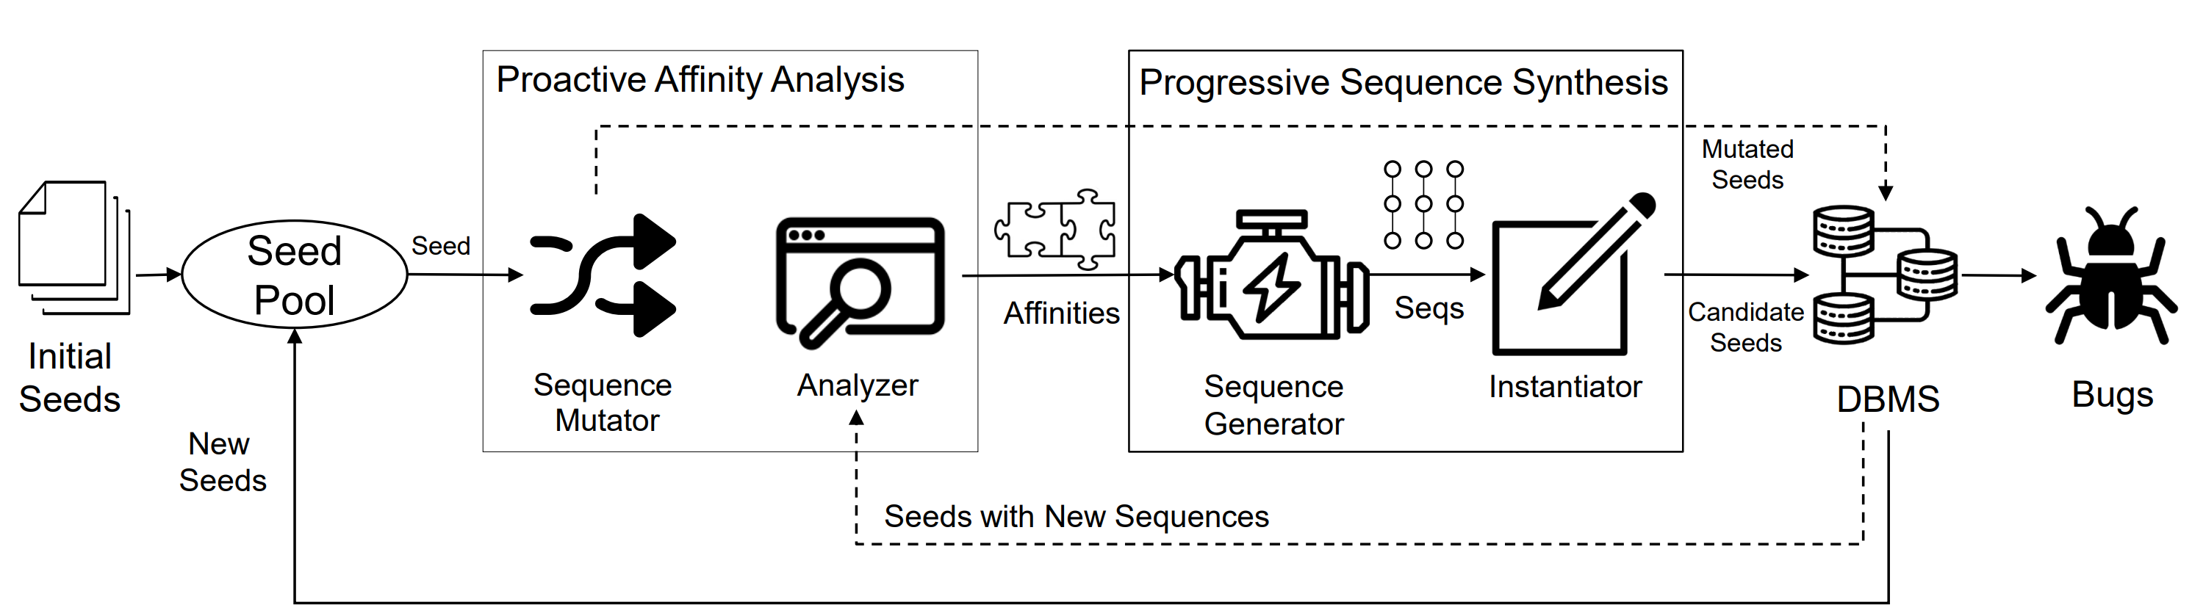
LEGO: Sequence Oriented DBMS Fuzzing
Notes:
In Step 1, LEGO explores the SQL type space to proactively analyze the affinities. It picks an existing seed from the seed pool, performs sequence-oriented mutation to change each statement’s type. If the mutated seed covers new branches in the target DBMS, then the type-affinity caused by type changes will be recorded. 2) In Step 2, LEGO exploits type-affinities to synthesize test cases progressively. When a new affinity is discovered, LEGO permutes all SQL Type Sequences containing the type-affinity. The sequence is then instantiated to executable test cases to feed into the target DBMS. With sequence-enriched seeds progressively synthesized from affinities discovered by proactive exploration, LEGO continuously explores the state space of the target DBMS and finds its bugs.

Slide 8
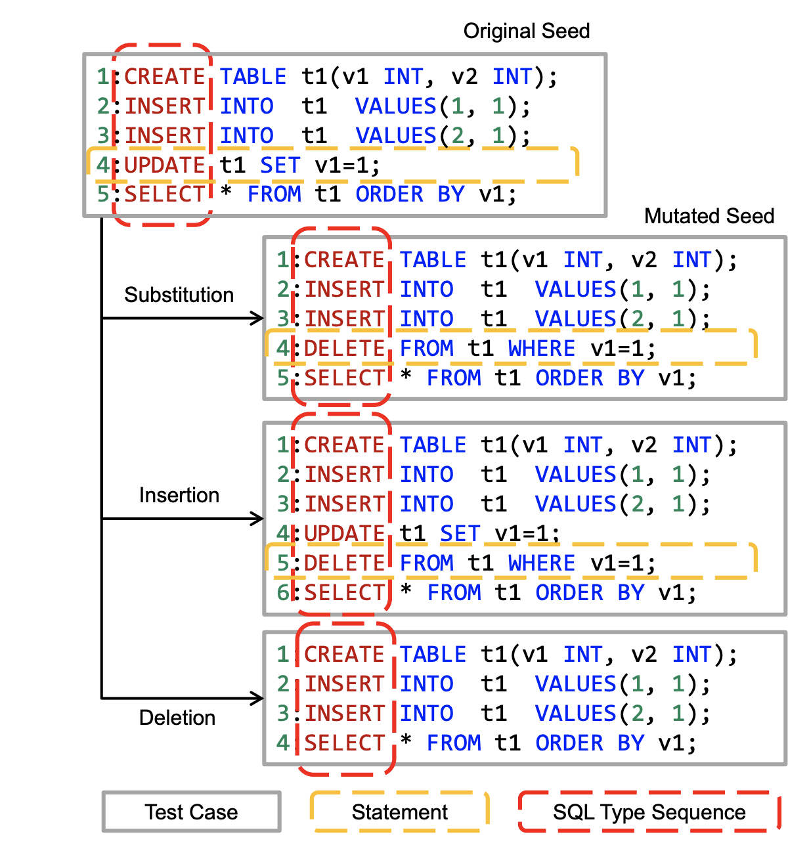
Proactive Affinity Analysis
Type-Affinity
Chronological relation between adjacent statements
CREATE TABLE → INSERT
Proactive Sequence-Oriented Mutation
Type-Affinity Analyze
Identify type
Parse affinity
Notes:
LEGO proactively produces new sequences by employing sequence-oriented mutation. Sequences that cover new code regions of mutated seeds will be considered meaningful and the type-affinities in them will be extracted.
Type-affinity is a chronological relation between adjacent statements. Specifically, if one statement follows close to another statement, we consider the types of the two statements to have a chronological relation. We use the partially ordered tuple (type1, type2) to represent this relation as a type-affinity, which means that type1 could be followed by type2.

Slide 9
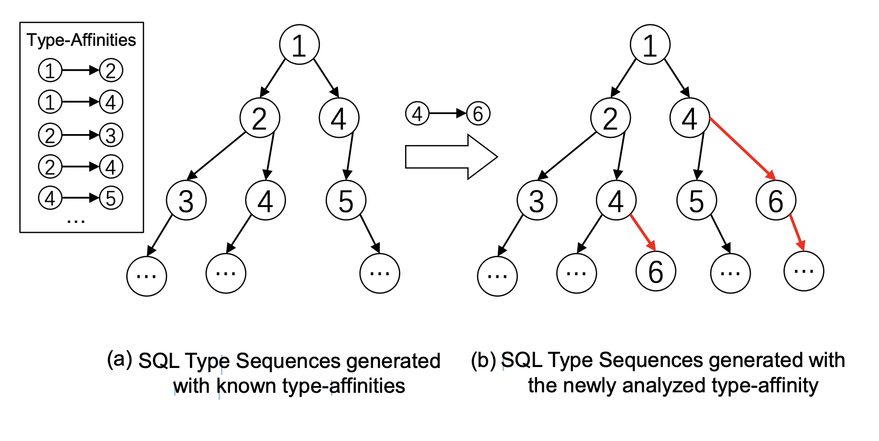
Progressive Sequence Synthesis
Instantiation
AST synthesis.
Statement concatenation.
Validation.
Analyze dependency
Fill with concreate values
Translate to executable test cases
Notes:
The instantiation includes three steps. First, AST synthesis. When finding a new seed, LEGO parses each of its statements to extract AST structures and saves them into the global library. In instantiation, for each entry in the SQL Type Sequences, LEGO randomly selects a type-matched structure from the library to build the AST. Second, statement concatenation. LEGO translates the AST of each entry into SQL statements and concatenates them into a candidate SQL test case. Finally, validation. The candidate test case is re-translated to an AST. The dependencies between different data are analyzed, and the AST will be filled with concrete values that satisfy all dependencies. After that, the AST is translated to an executable test case and fed to the target DBMS. Because of the randomness in selecting structures, one SQL Type Sequence will be instantiated multiple times to increase the diversity for combinations of AST structures and type sequences.
For example, with the sequence “PRAGMA→ CREATE TABLE→ INSERT”, LEGO first constructs the SQL statement skeleton and instantiates some SQL data with random values, like “PRAGMA foreign keys=on; CREATE TABLE v0(x INT PRIMARY KEY, y INT REFERENCE); INSERT INTO v2(v1) VALUES(100);”. This test case contains semantic errors because TABLE v2 is not exist. Then, LEGO builds the data dependency graph of the SQL statement and fixes it with the correct data. Finally, the instantiated test case is “PRAGMA foreign keys=ON; CREATE TABLE v0(x INT PRIMARY KEY, y INT REFERENCE); INSERT INTO v0(x) VALUES(100);”.

Slide 10
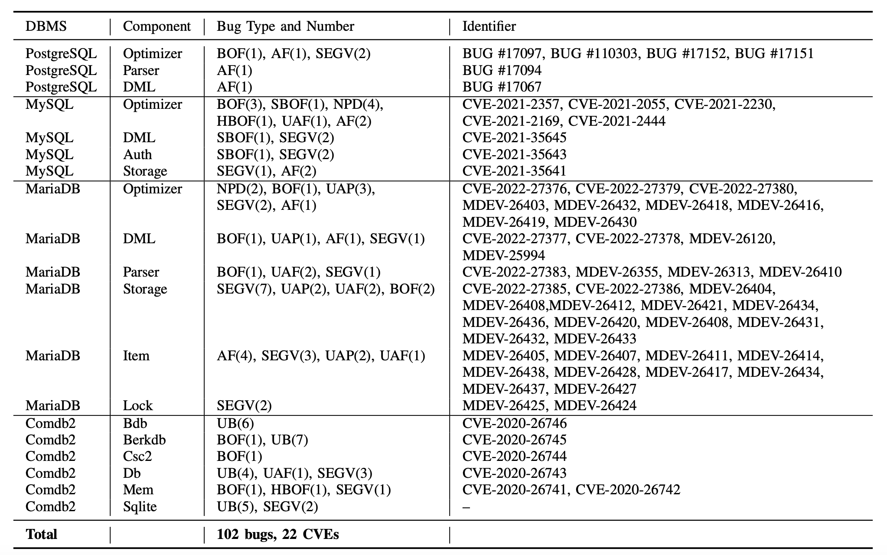
Evaluation (1/3): New Vulnerabilities
102 Bugs
22 CVEs
High risk: 8
Medium risk: 8
Reserved: 8

Slide 11
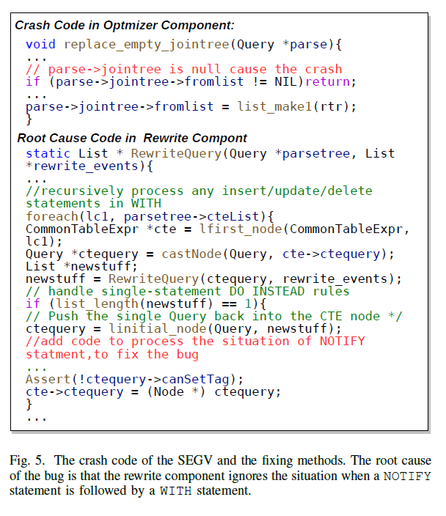
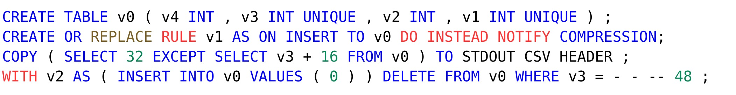
Case Study: A SEGV in PostgreSQL
Query
NOTIFY
WITH

Slide 12
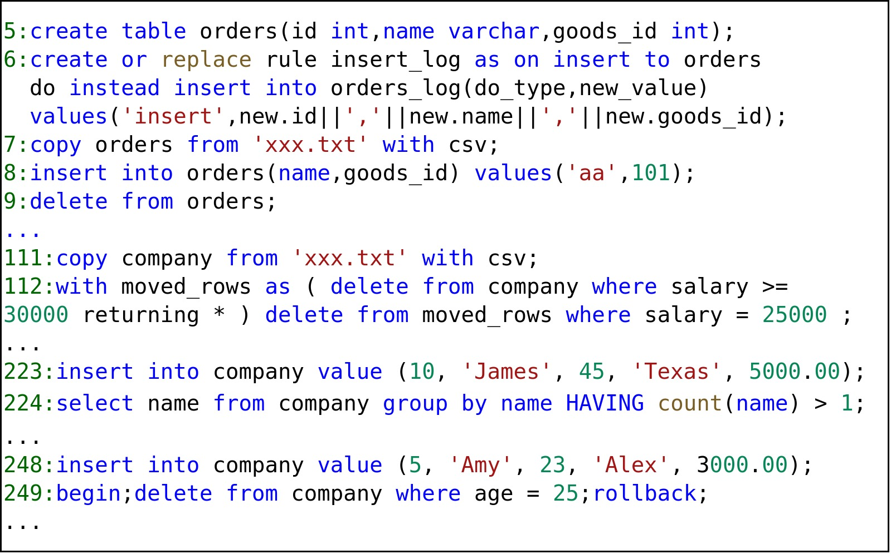
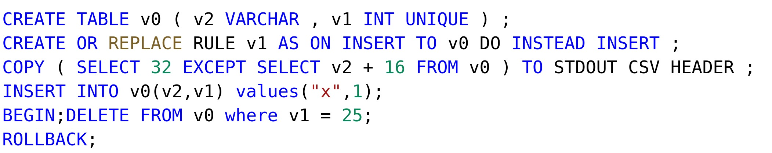
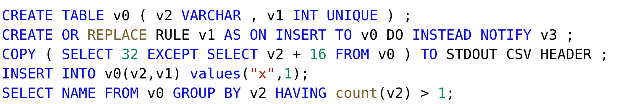
How LEGO Find The Bug
RULE NOTIFY, WITH, …
RULE NOTIFY, TRANSACTION…
Original Seeds
RULE NOTIFY, HAVING …

Slide 13
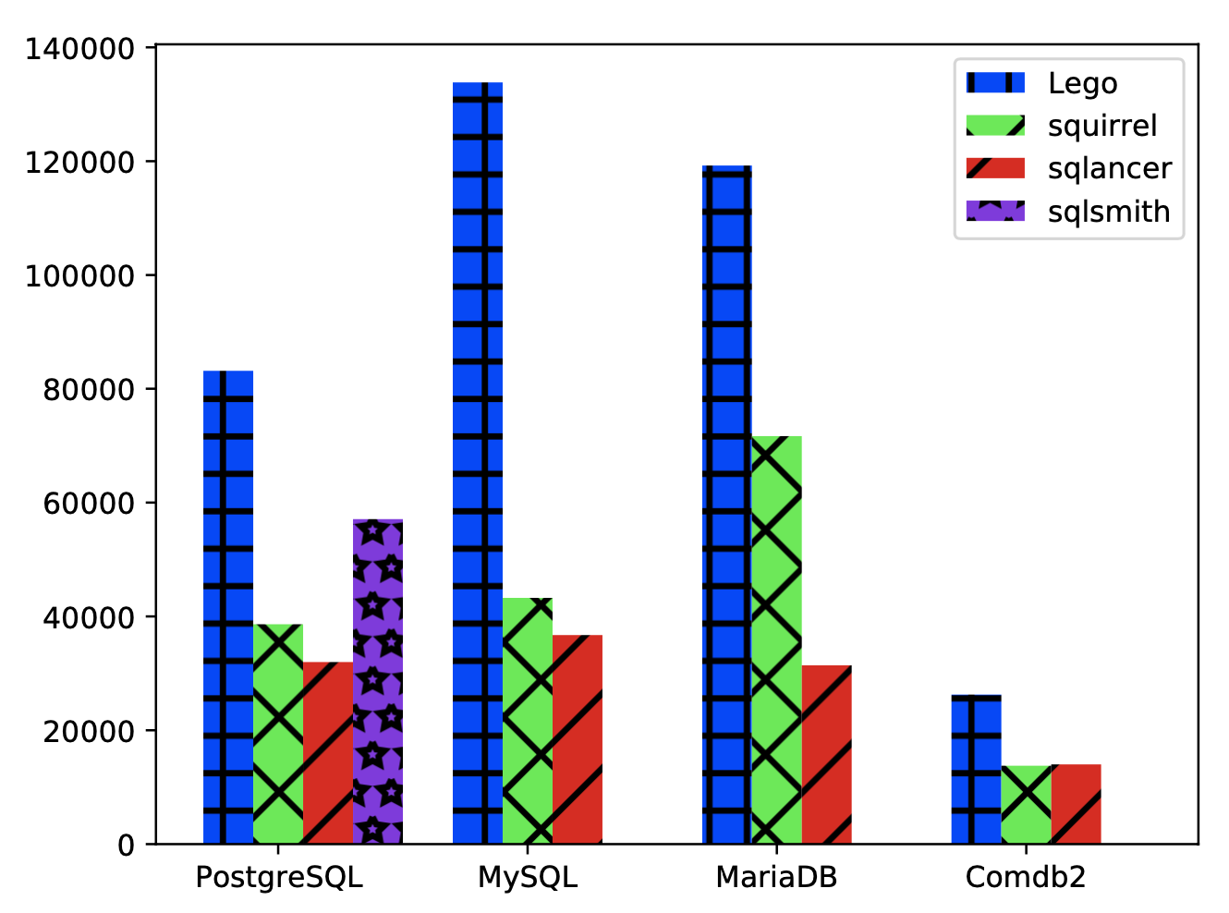
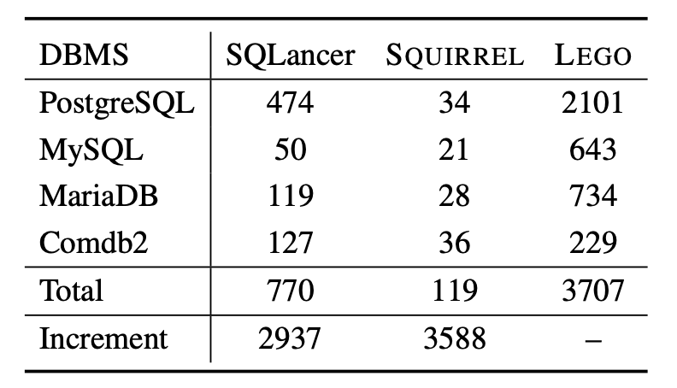
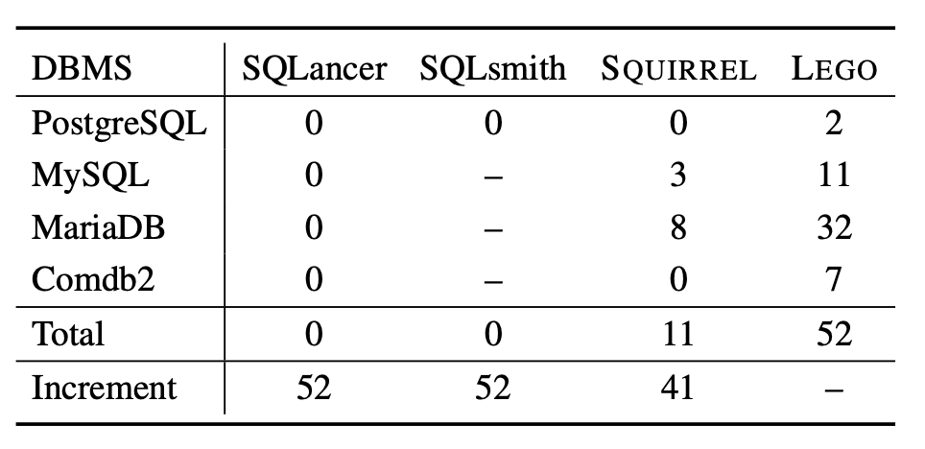
Evaluation (2/3): Comparison to Other Fuzzers
Covered Branches
Type-Affinities
Bugs
44% ~ 198% more covered branches
More type affinities
More unique bugs

Slide 14
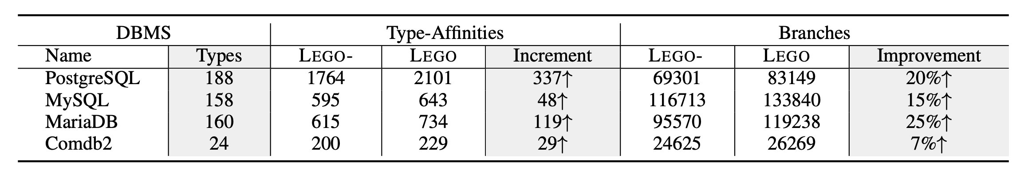
Evaluation (3/3): Effectiveness of Sequence-Oriented Algorithm
LEGO-: Disable Sequence-Oriented Algorithms
On average
17% more branches
15% more type-affinities
More types, more improvements
Notes:
when a DBMS has more statement types, LEGO tends to make more type-affinity increments while making more branch coverage improvements
19%
8%
19%
15%

Slide 15
Conclusion
Goal: Increase fuzzing coverage + find more bugs
Motivation: Abundance of SQL Type Sequences is important
Method: Sequence-Oriented DBMS Fuzzing
Proactive Affinity Analysis
Progressive Sequence Synthesis
Evaluation: 4 DBMSs, 102 new bugs, 22 CVEs
Notes:
This paper presents LEGO, a fuzzer that automatically analyzes type-affinities to increase the abundance of SQL Type Sequences. It first analyzes the type-affinities from any two adjacent statement types that appear in test cases generated by proactively sequence-oriented mutation. Then it synthesizes new sequences based on the analyzed affinities. LEGO outperforms three state-of-the-art fuzzers on four popular DBMSs, namely PostgreSQL, MySQL, MariaDB, and Comdb2. More importantly, LEGO finds 102 new vulnerabilities. Among them, 22 bugs are confirmed as CVEs due to their severe security influences. Our future work will focus on refining the type-affinity analysis to improve efficiency.

Slide 16
Thank You

